Slide 1

SMART HOME AUTOMATION
Final Year Project Review #2
Dept. of Electrical Engineering
PRESENTED BY:
DEEPAK YADAV
DIVYA JYOTI
PREETY KUMARI
PIYUSH KUMAR
MONIKA KUMARI
UNDER THE GUIDENCE OF
Mr. TANMAY DAS
Assistant Professor
Department of Electrical Engineering

Slide 2
INTRODUCTION
Today's life rolls around the concept of automation and the things that are automated are said to reduce the interference of human beings.
A smart home automation system is a system to achieve some activities executed in daily life to get more comfortable and easier life environment automatically.
The system is designed using Adriano and to provides security to the home aong with monitoring the temperature, humidity, PIR motion sensor, LPG sensor, and fire sensor to guarantees the family security.

Slide 3
OBJECTIVES
We are controlling the parameters like temperature, Humidity, Water level, home lightning and Various power appliances along with monitoring the LPG gas.
Giving user the flexibility to control and monitor the parameters through web(http bas control and monitoring).
Intelligent system design for optimizing the power use

Slide 4
BERIEF THEORY
System Activation
User Interface
Controlling Parameters
Temperature
Humidity
Level
LPG gas sensing and system reaction
Light detection and lightning system

Slide 5
Devices and Sensors
Arduino
Bluetooth Module
Temperature sensor
Humidity Sensor
LPG gas sensor
Ultrasonic Sensor
Proximity Sensor
Light Sensor
Arduino Uno HC-05 (BC 417) LM35
DHT11 MQ-9 HC-SR04
LJ12A3-4-Z/BX-5V M12 LDR

Slide 6



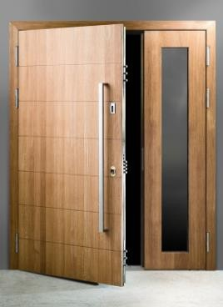




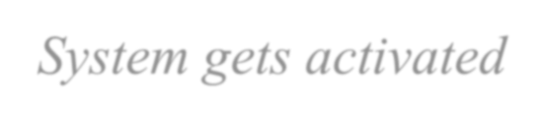
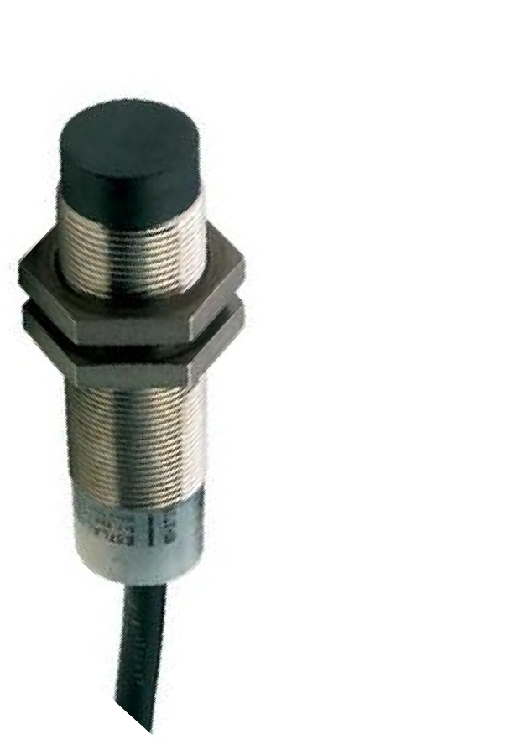

On door Closing
Close the appliances
Keep logging the data
On door opening
Control mechanism starts working
System gets activated
Fig. 1. Inductive proximity sensor
Fig. 2. Door lock system

Slide 7

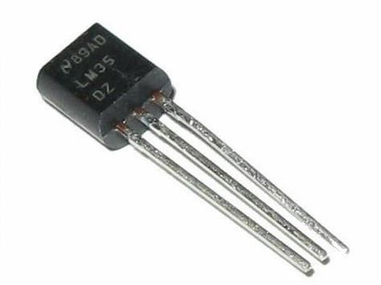

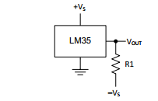
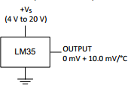





Temperature Sensing
We are using LM35 integrated-circuit temperature devices with an output voltage linearly proportional to the Centigrade temperature.
Linear + 10-mV/°C Scale Factor
0.5°C Ensured Accuracy (at 25°C)
Less Than 60-μA Current Drain
Low Self-Heating, 0.08°C in Still Air
Mode of operations
Fig. 6. LM 35
Range 2°C to 150°C
Fig. 4. Basic
Configuration of LM 35
Range -55°C to 150°C
Fig. 5. Full Range Configuration

Slide 8

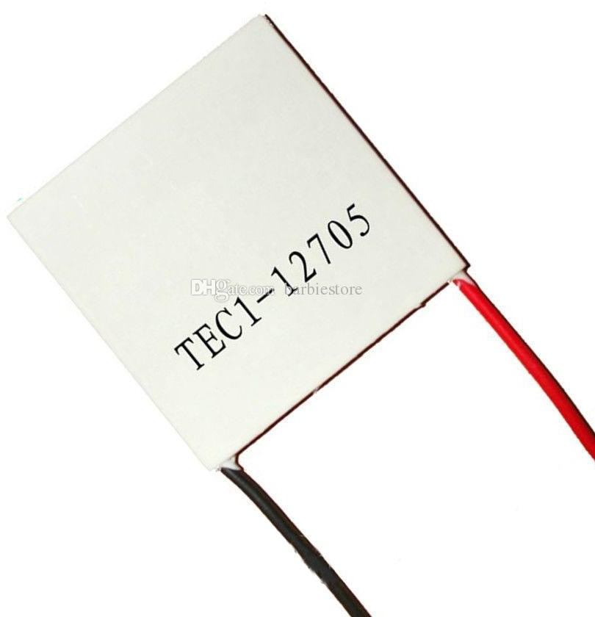
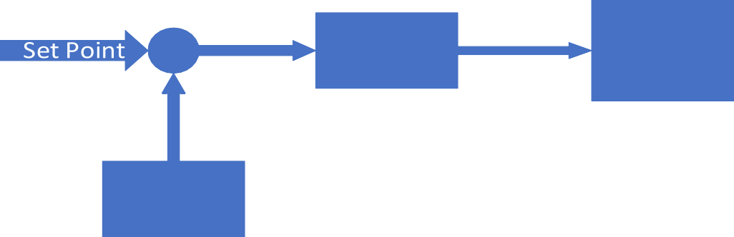
Temperature Control
We are using Peltier element to keep the
temperature of room below set point value.
We are not using heater system to rise the temperature in case of coldness.
Close loop control is used for maintaining
the temperature around set point.
Control algorithm are done in LabVIEW.
+
Fig. 9. Door lock syste
LM 35
Fig. 8. Block diagram of Temperature Control

Slide 9


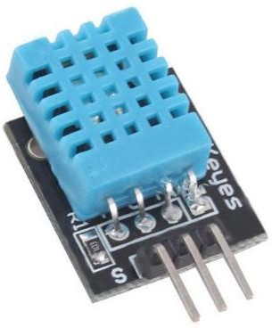


Humidity Sensing
We are using DHT11 for Humidity measurement
Digital Sensor with 16bit resolution
Measures relative Humidity
Accuracy: At 25℃ ± 5% RH
Repeatability: ±1% RH
Low power
Supply Current : 0.3mA
Standby Current : 60μ A
DHT11 is a composite Sensor contains a calibrated digital signal output of the temperature and humidity
The sensor includes a resistive sense
of wet components and an NTC temperature measurement devices, and connected with a high-performance 8-bit microcontroller.
Fig. 11. DHT11 Sensor

Slide 10

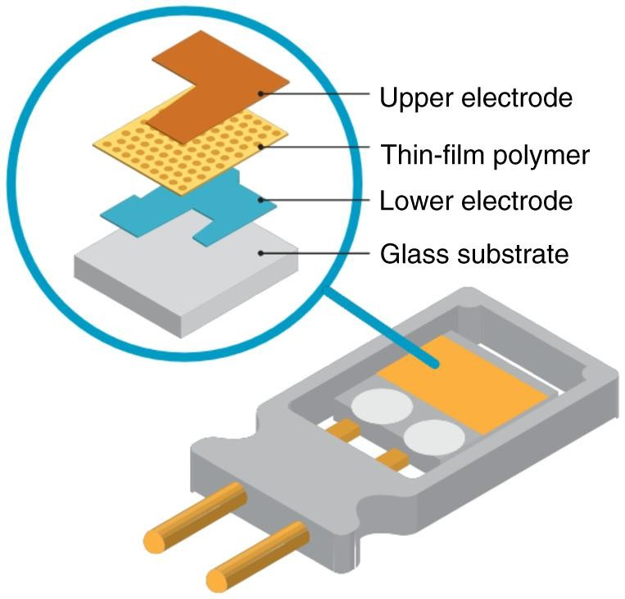
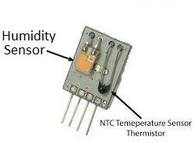
Working of DHT11
The DHT sensors are made of two parts, a capacitive humidity sensor and thermistor.
There is also a very basic chip inside that does some analog to digital conversion and spits out a digital signal with the temperature and humidity.
Fig. 12. Construction of DHT11 humidity sensor

Slide 11

Humidity Control
Control of Humidity basically requires water vapour absorbers which are chemicals.
We are using exhaust to change the room air continually.
Data received from the DHT11 through Arduino Uno.
Arduino transfers this data to LAB view through Bluetooth module.
LAB view receives this data and compare with desired set point (set by user).
The error signal is passed to ON-FF controller and the signal comes out and goes to power MOSFET.
MOSFET drives the relay.
Relay drives the exhaust fan.

Slide 12

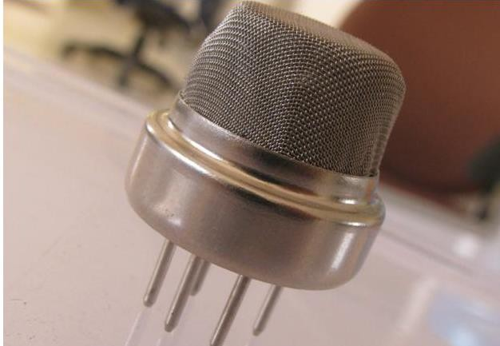
LPG Sensing
We are using MQ-9 Gas Sensor
High sensitivity to carbon monoxide and CH4，LPG
Environment conditions
Operating temperature: -20 – 50 °C
Relative Humidity : less than 95%

Slide 13

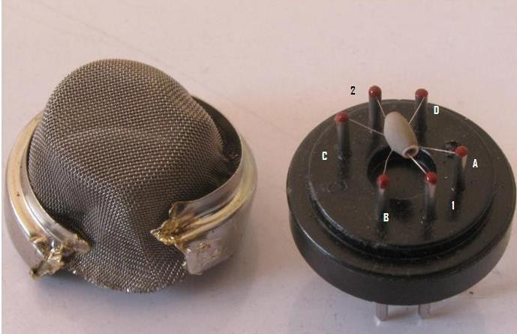
The Sensing Element
Fig. 15. Image Showing a Hexapod Structure Inside a Gas Sensor

Slide 14
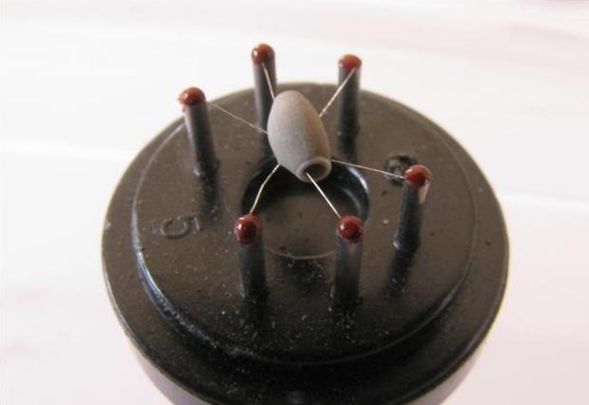
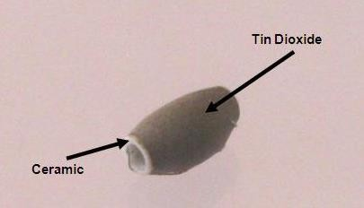
Fig. 17. Sensing Element
Fig. 16. Closer Look at the Hexapod Structure

Slide 15
Working of LPG Gas Sensor
Any gas to be monitored has specific temperature at which it ionizes.
The task of the sensor is to work at the desired temperature so
that gas molecules get ionized.
Through Nickel-chromium wire, the ceramic region of the sensing element is subjected to heating current.
The heat is radiated by the element in the nearby region where
gases interact with it and get ionized.
Once, ionized, they are absorbed by the tin oxide. Adsorbed
molecules change the resistance of the tin oxide layer.

Slide 16
SENSING
LDR -An LDR is a component that has a (variable) resistance that changes with the light intensity that falls upon it.
As LDR is nonlinear device we are using range to give user the sense of lighting condition using 4 indicators
High intensity, Medium Intensity, Low Intensity and for Dark conditions

Slide 17

Room light Control
We are giving 3 light control in a room one for high intensity light (tube
light), one for medium light intensity ( CFL or LED bulb ) and one night
bulb options.
User has 4 options(as control) which are same as indicators.
Depending on the user set choice and light detection by LDR the bulb is automatically controlled by the LAB view with the help of Power MOS and relay.

Slide 18

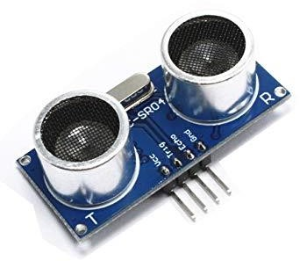


Level Sensor
Ultrasonic Sensor HC-SR04
The ultrasonic ranging module includes ultrasonic transmitter, ultrasonic receiver and control circuit. The transmitter is used for transmitting UV rays while the receiver receives it.
Features:
Fig. 20. HC-SR04
Ranging Distance : 2cm – 400 cm
Resolution : 0.3 cm
Measuring Angle: 30 degree

Slide 19
Level Sensor Working
The Trig pin of the HC-SR04 is provided a high level signal for at least 10 micro-second.
The module automatically sends eight pulses of 40kHz and detect whether there is a pulse signal back.
Till the time there is no received UV ray by the receiver, the echo pin stays high. As the rays are received, the echo pin goes low.
We can calculate the distance of the obstacle using the
formula
Distance= (high level time*velocity of sound)/2

Slide 20
PROPOSED METHODLOGY
Smart Home Automation using Smartphone to control the appliances using Adriano or ESP32 it's combine all the appliances with relays including temperature sensor, humidity sensor ,smoke sensor, water level sensor and LDR.
ESP32 is WI-FI and Bluetooth inbuilt microcontroller it's sense the parameter from our surrounding with the help of different parameter sensor.
We can also control the appliances without internet using IR Remote and manual switch and also show the real-time feedback.

Slide 21
FUTURE SCOPE OF HOME AUTOMATION USING ARDUIANO
Home automation is the wireless and remote control of different aspects of a living space like lighting, temperature, security, entertainment,etc.
Cost-effective: Home automation appliances have a longer life cycle than the regular device.Hence this saves money.
Eco-friendly: The smart home appliances consume a minimum amount of power. This is because they use stored user data to modify the output. This means a fair amount of energy is saved.

Slide 22
FUTURE SCOPE OF HOME AUTOMATION USING ARDUIANO
In the future, home automation is definitely going bigger and better.. Users could make their favourite beverage with voice instructions, or instructions to the smartphone can close the blinds in the living room while residents are far away on vacation. The most useful advantage is, however, the aspect of sustainability.Home automation works on the principle of sustainability,which encourages the wise use of resources.

Slide 24
PLAN AND THE SCOPE OF THE WORK
So as we have seen, till now we have controlled variables like temperature, humidity, level and lightning system.
In future we are working on web based control to provide more flexibility to interact with the system.
User will have flexibility to connect to common Wi-Fi and using IP he/she can control and monitor the whole process.
We are also working on making the system intelligent by integrating the our IOT based module with lab VIEW.

Slide 25
REFERENCE
www.google.com
www.wikipedia.com
www.arduino.org

